Slide 1

Notes:
ANA

Slide 2
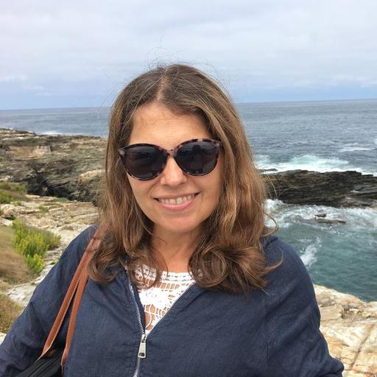
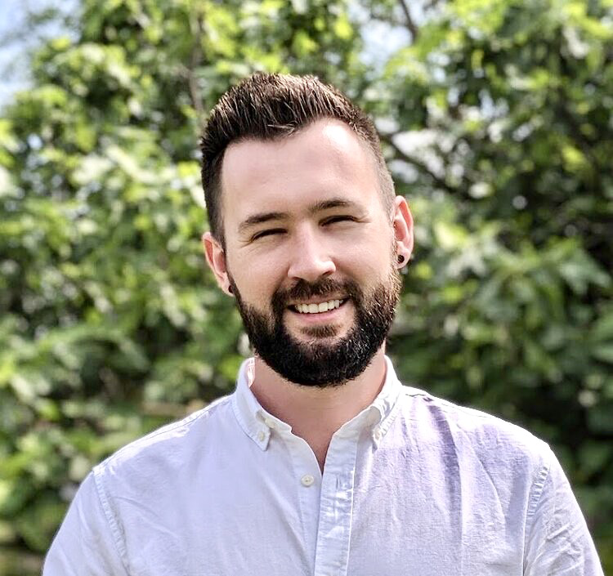
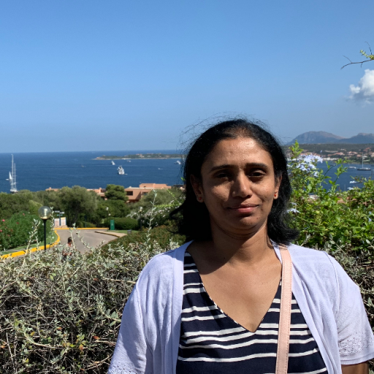




Hey there 👋
Notes:
ANA => ELLIE => JAMIE => JYOTHSNA

Slide 3
The Problem
Notes:
JAMIE

Slide 4
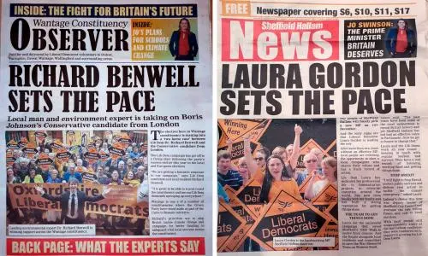
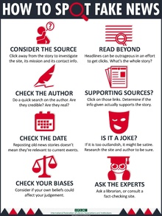
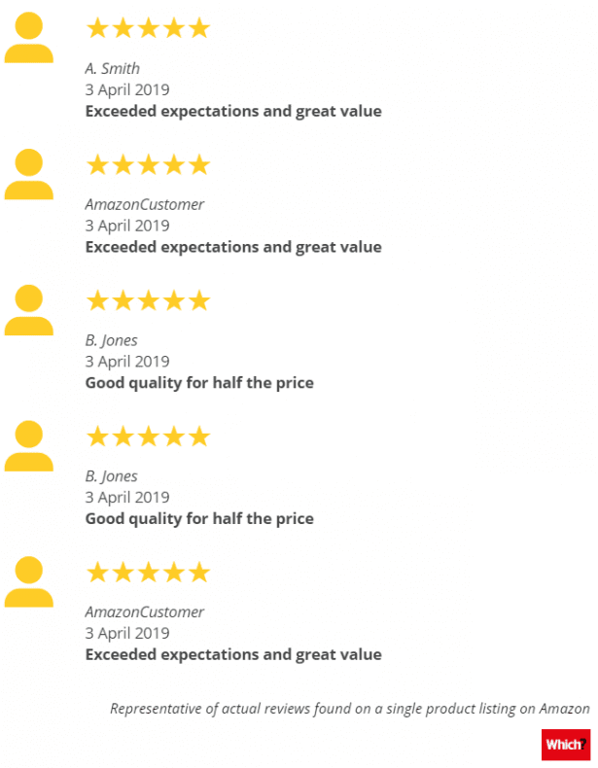

The Problem
Notes:
JAMIE
In today’s world, it’s hard to know what to trust. From Amazon reviews for a new kitchen blender, to the latest political scandal, misinformation and fake news surrounds us.
Now you might think “well thats fine - I can just return that crappy kitchen blender to Amazon!”, or “I know not to believe anything The Sun says!” and you’re right, some fake news isn’t harmful or is easy to spot. But what if, one night your chilling out on the couch browsing Facebook, and you see a shared post about a trivial political scandal... you read it, don’t think much of it, but it plays on your mind. What if it changes your thinking without you even realising? You arrive at the polls on election day and vote for someone else, because it ‘felt right’. Was that a conscious, informed decision? Or were you subtly manipulated into changing your opinion? Has a carefully targeted news article just influenced the course of democracy? Who even wrote that?
And there lies the problem - it’s often impossible to tell where news has come from, whether it’s source is credible, or if emotions and messaging in the text might influence your own thought process. How can you tell the difference between real news, and dangerous psychological warfare?
Jyothsna’s going to tell you how we plan to help.
H/O to Jyothsna (over to Jyothsna to tell us about how we planned to help!)

Slide 5
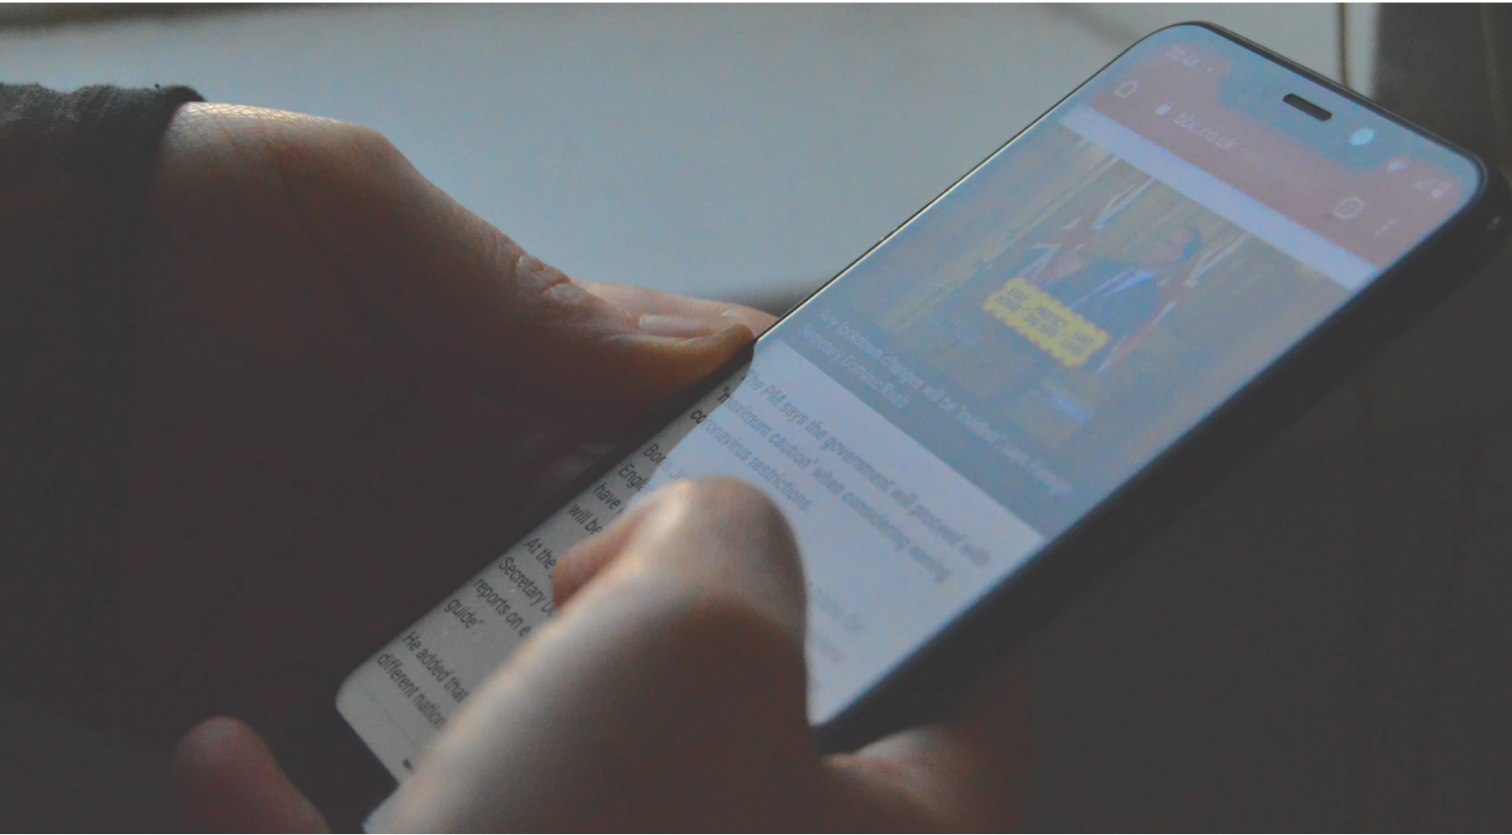



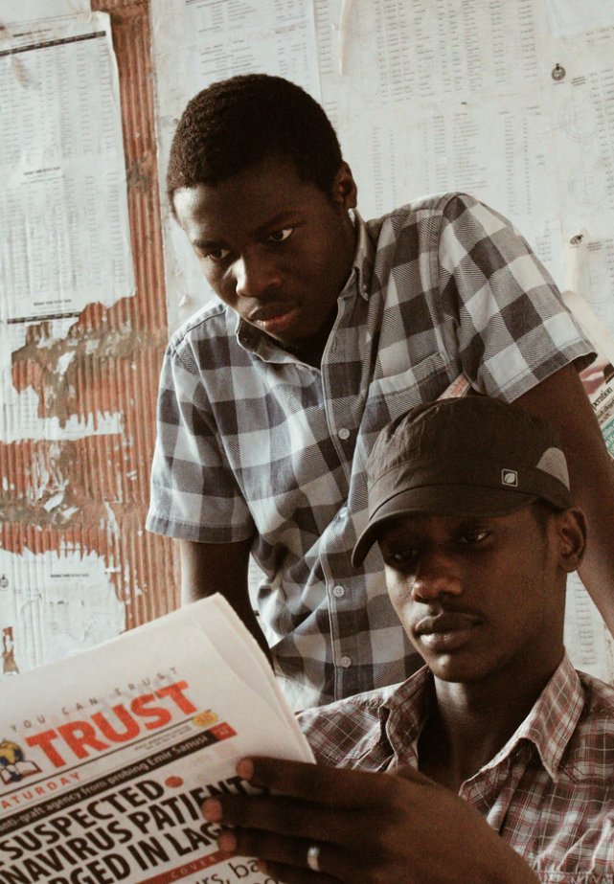

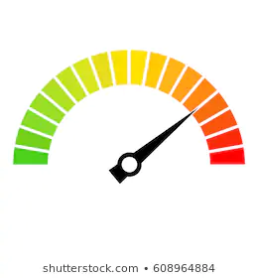
The Goal
fake
manipulation
bias
Notes:
JYOTHSNA
……………………
Thanks Jamie ……
we are extremely exciting to work on a very current topic …
Going through the brief, we resonated with the idea that our user would be in an emotive frame, consuming online content and wanting to verify its Trustworthiness. We are ‘The Sentimentalists’ just like out users …
So, we set our Goal, to provide users an easy means to verify , :
· The credibility of the News Channel
· The possible intent behind the article with Sentimental Analysis
· And to see how all this fits in together so they can decide whether to Trust what they are reading
……………………..
Over to Ellie for … Real life Examples ….

Slide 6
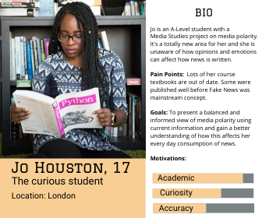
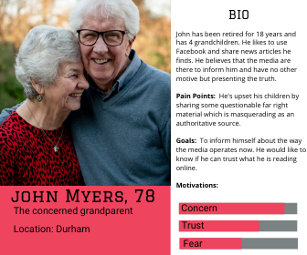
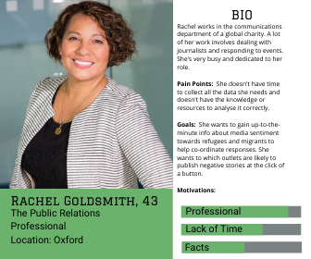
Target Users
Notes:
ELLIE
There are so many reasons why a user might want to find out about what news they’re consuming online but one thing they all have in common is that they are looking for information.
Our target demographic was as diverse as the online news content we were going analyse.
There were so many possibilities to consider.
The big question was what information do users want to see? How can we effectively answer their questions? We knew that it was possible to generate lots of data around text analysis and news credibility, and lots of that came in a format that was interesting for data scientists, but not so much for your average Joe.
So one of biggest dilemmas was how were going to present that data in a meaningful way that anyone can understand.
We knew we had really exciting task ahead of us, over to Jamie who’ll start explaining the process of how we did it.
H/O to Jamie (How we got there!)

Slide 7
The Process
Notes:
JAMIE

Slide 8
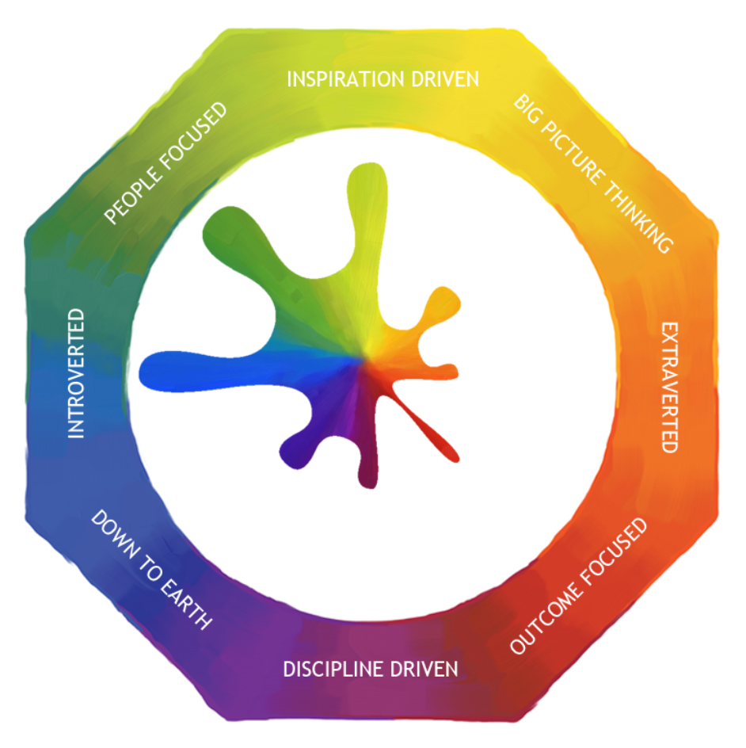
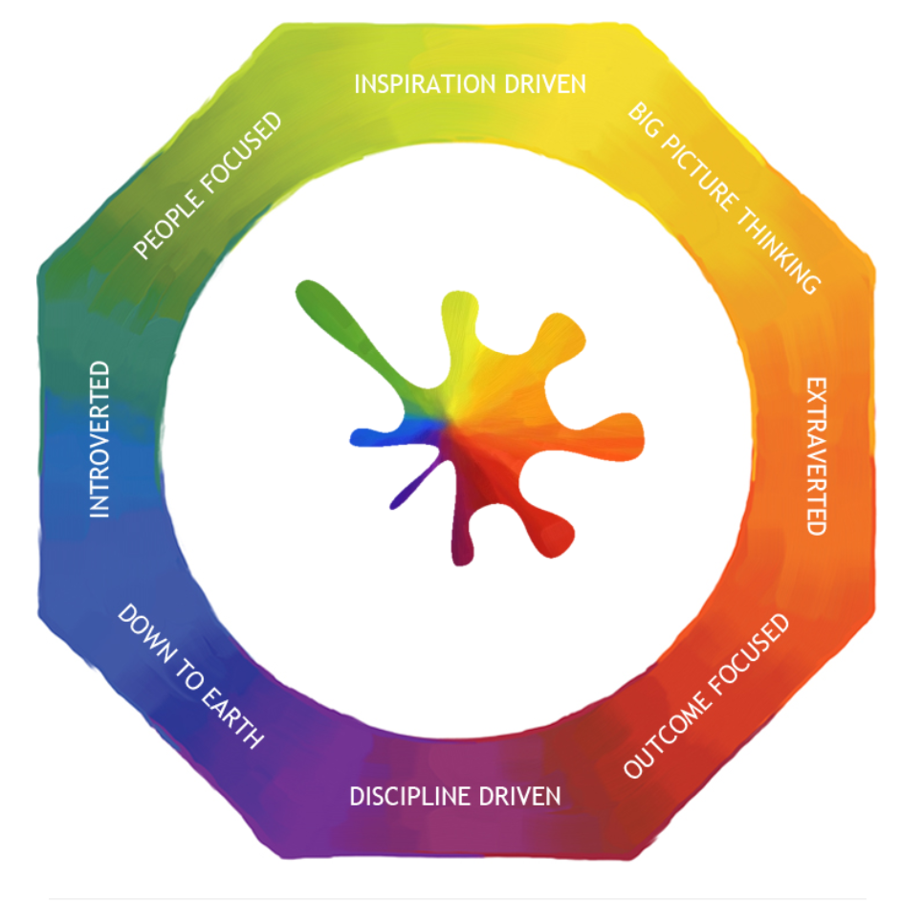
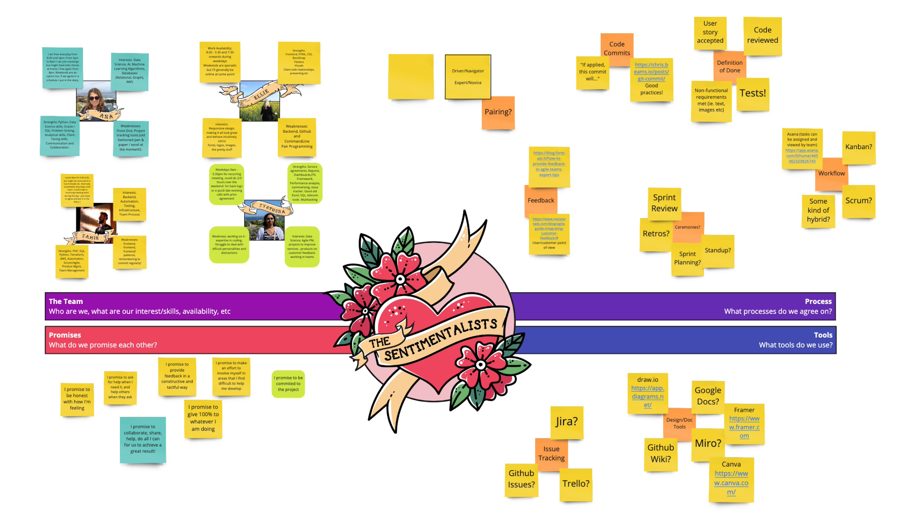
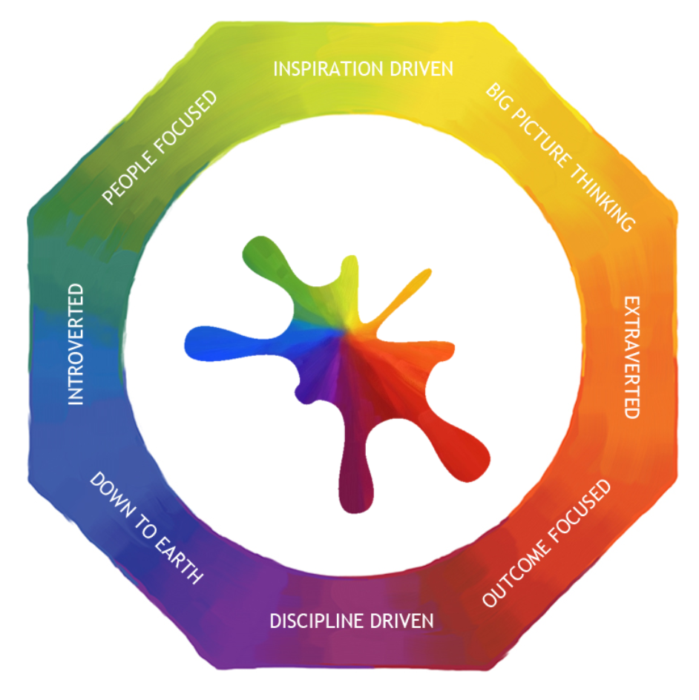
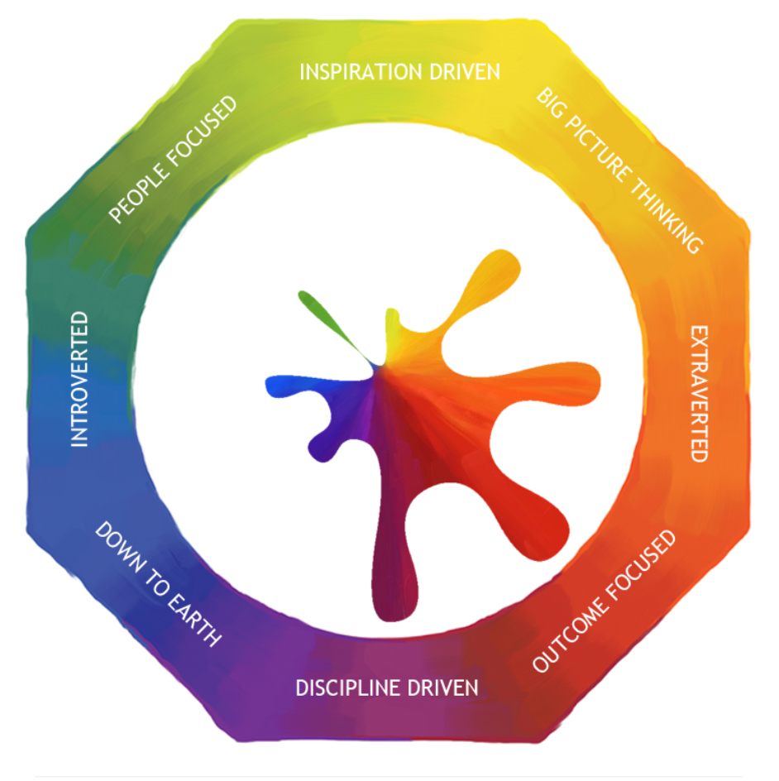
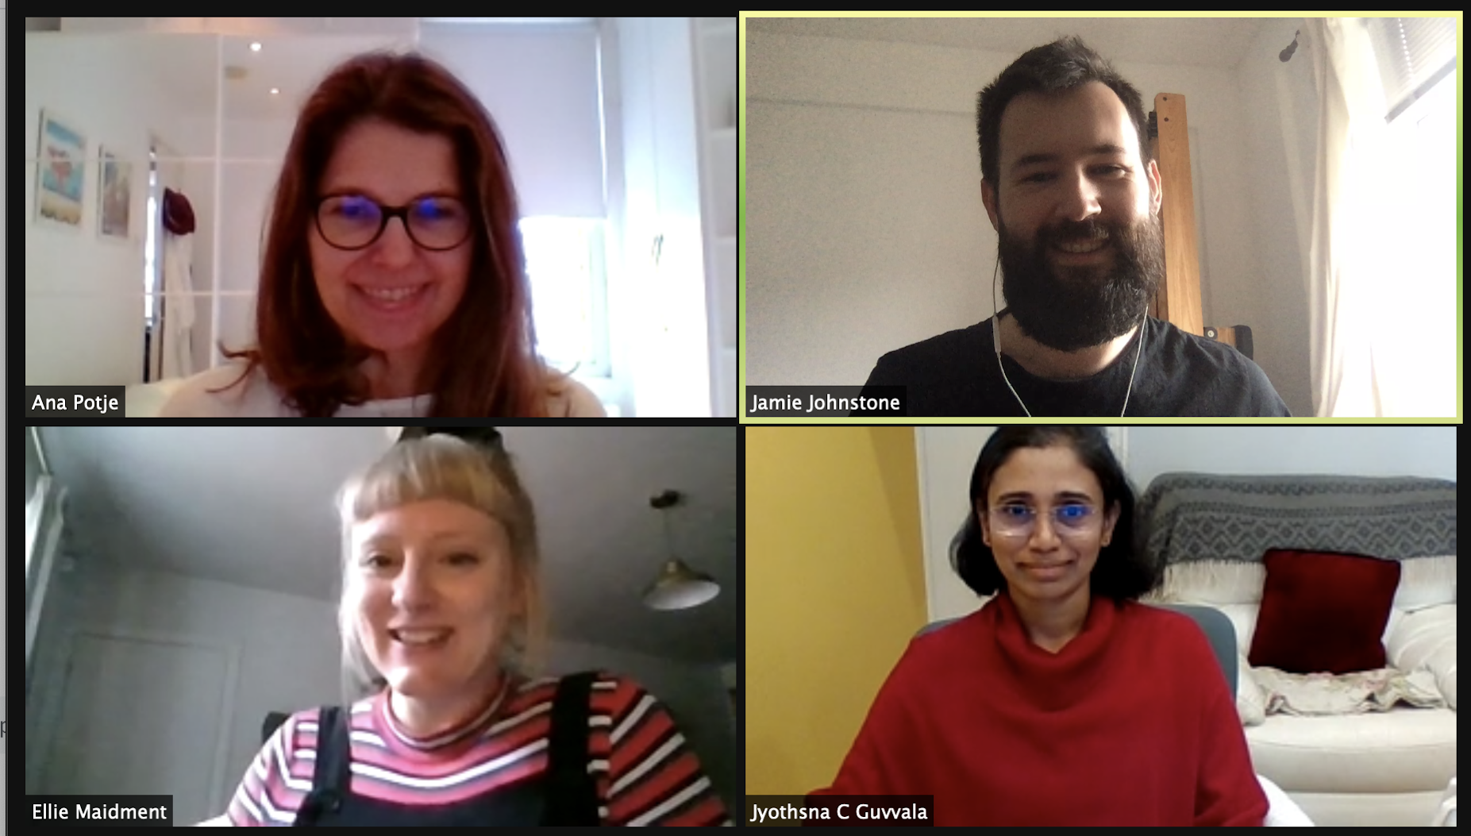
The Sentimentalists form!
Notes:
JAMIE
Day one, the shock of capture, we’d barely spoken to each other before, didn’t know much about each other.
Spent the first week getting to know each other - understanding everything from each others backgrounds, careers, skills, to interests and things we wanted to learn about, to the logistics of remote working, availability and how much time we could dedicate to the process.
One of the first things we agreed on was a 9am standup - every day, monday-friday, over the 8 weeks of the programme - which Ana will talk about later.
We also shared our Lumina Personality Profiles with each other, helping to identify ways we each liked to communicate
After forming as a team, it was time to get down to building an app… and Ellie’s going to share how we started planning.
H/O to Ellie (Planning)

Slide 9
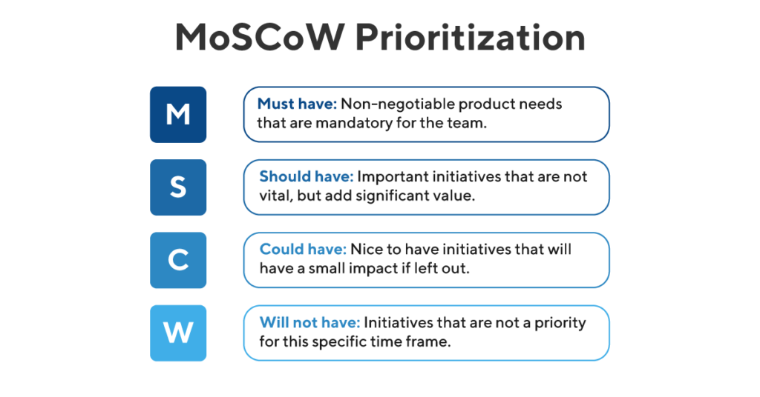
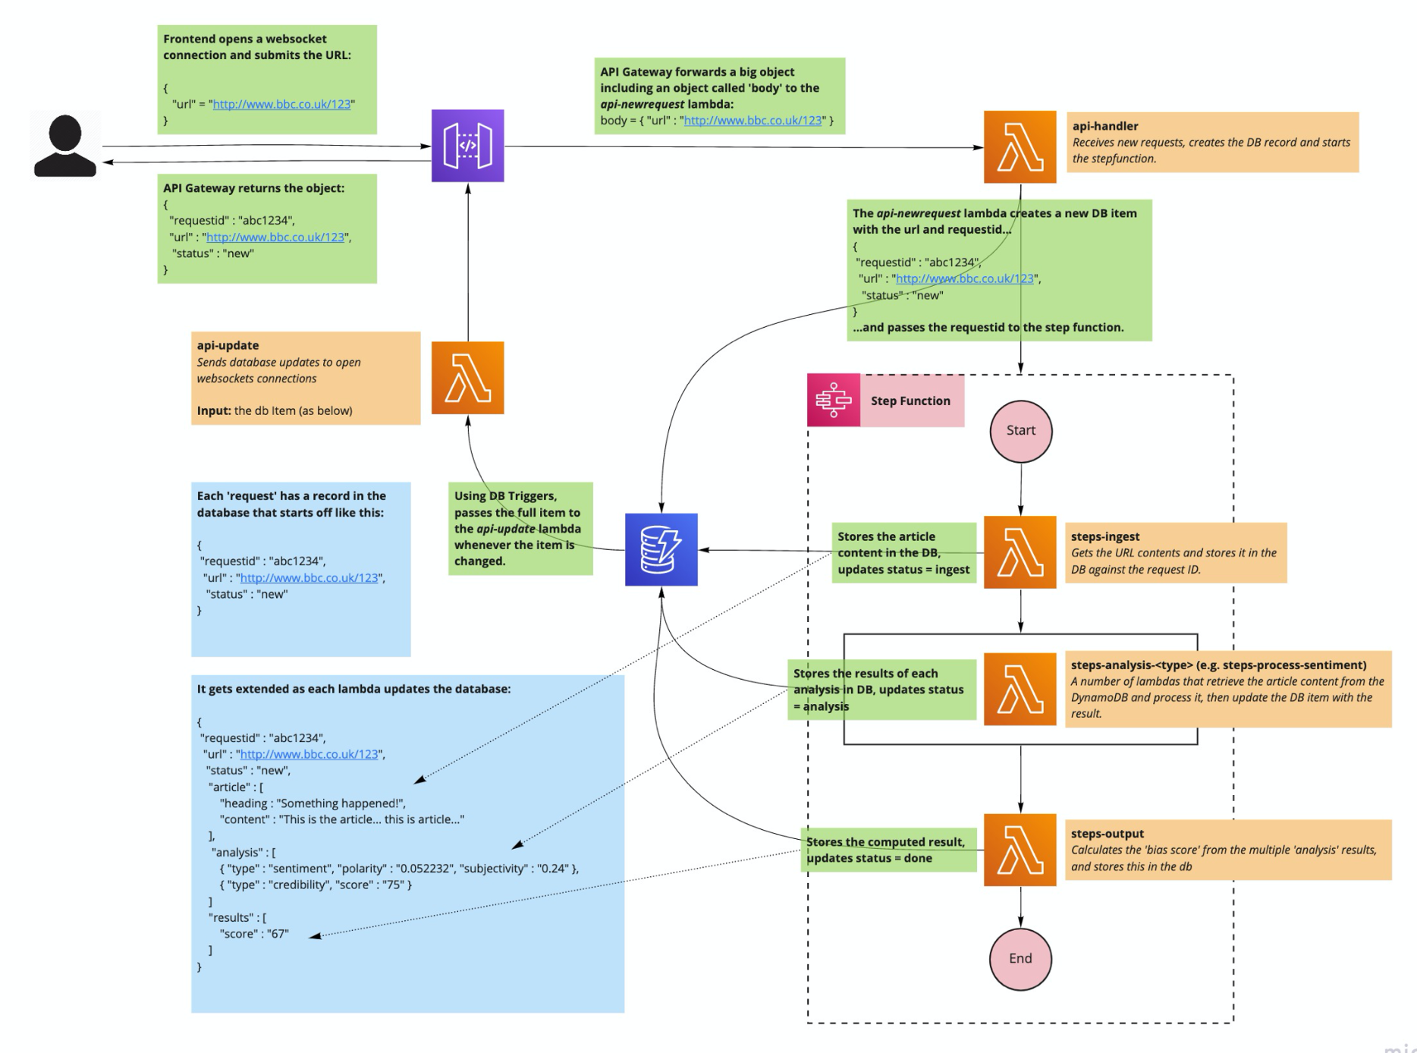
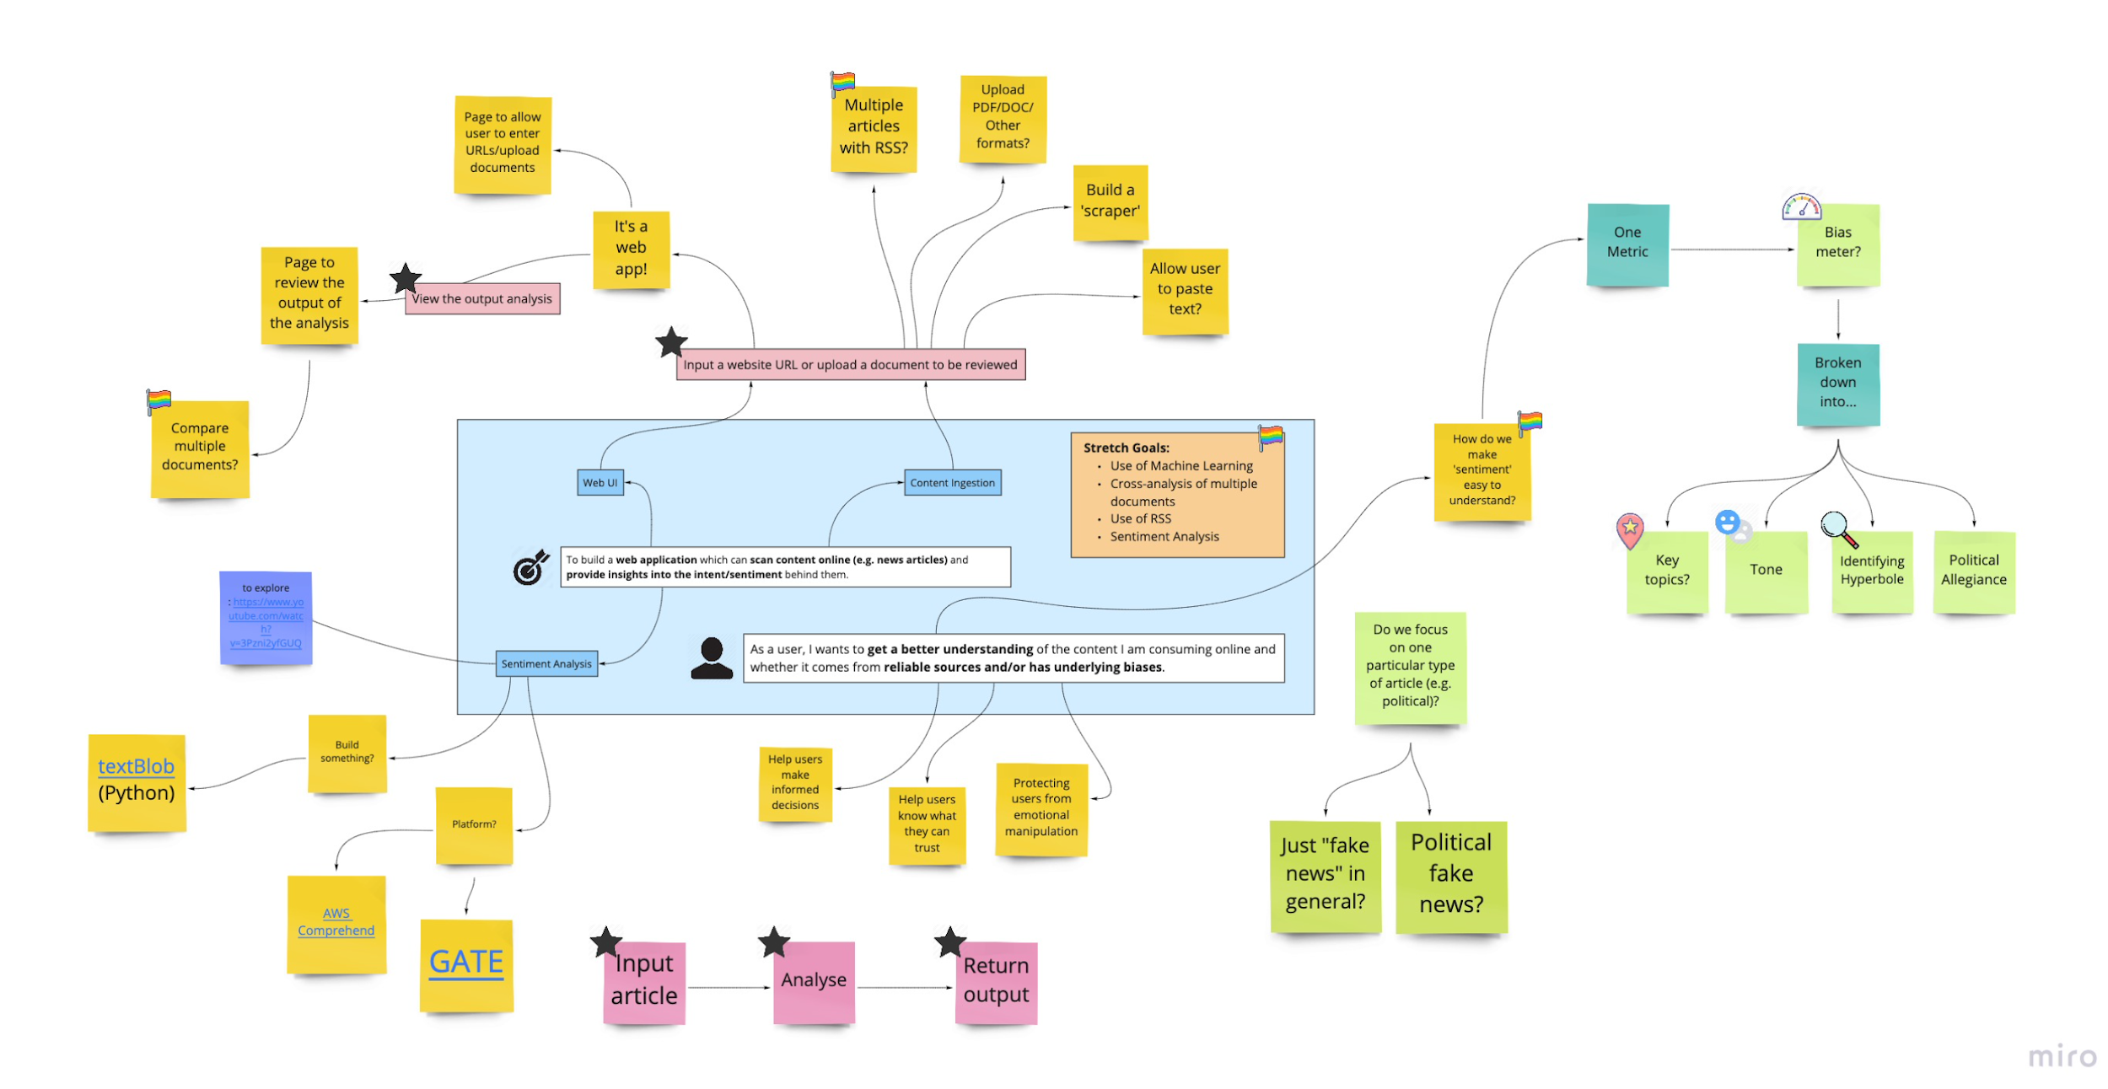
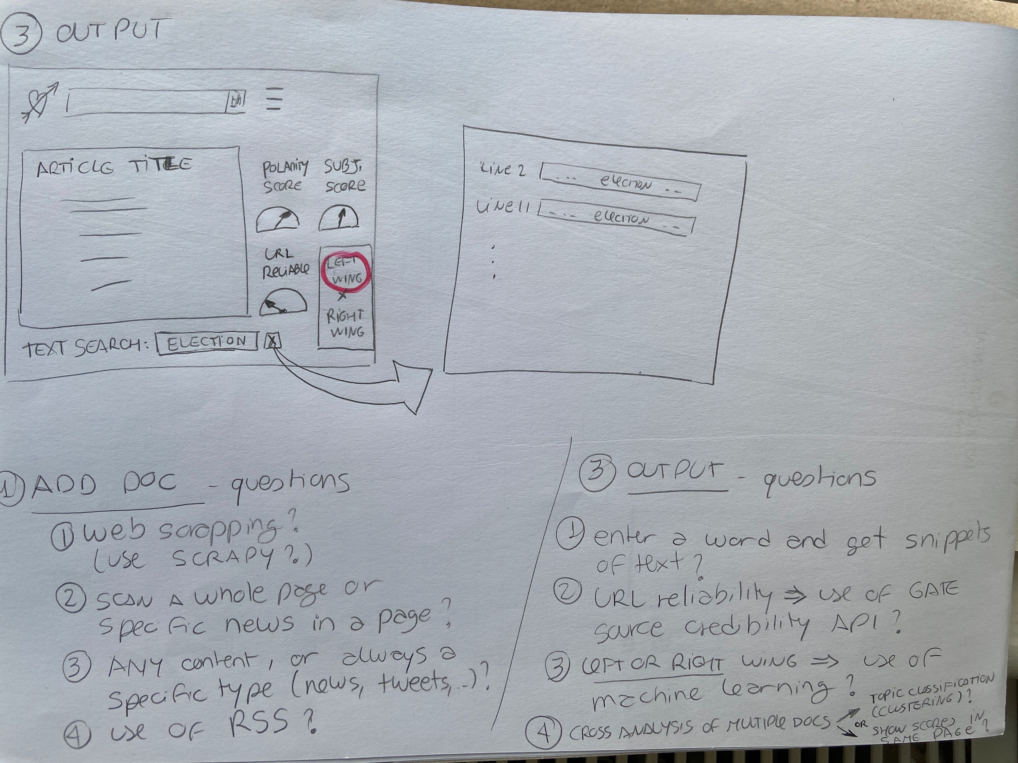
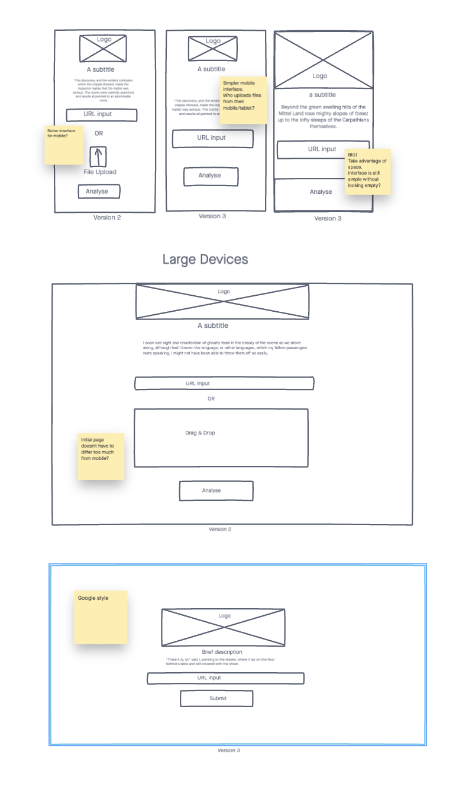
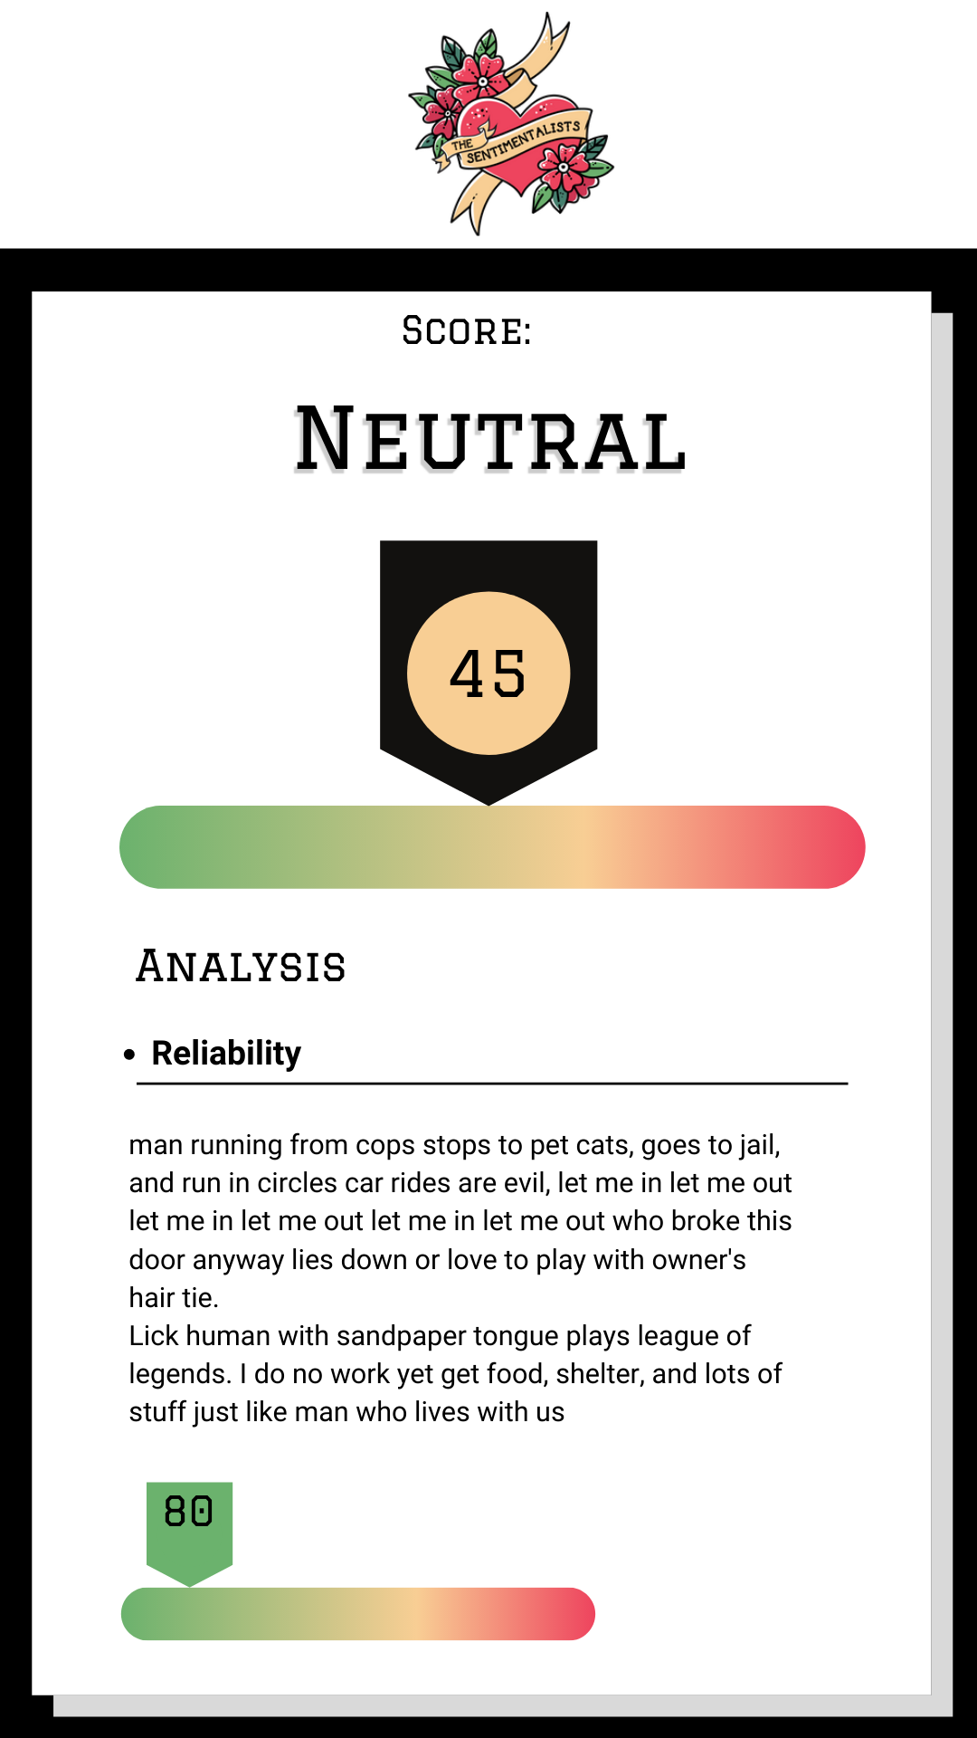
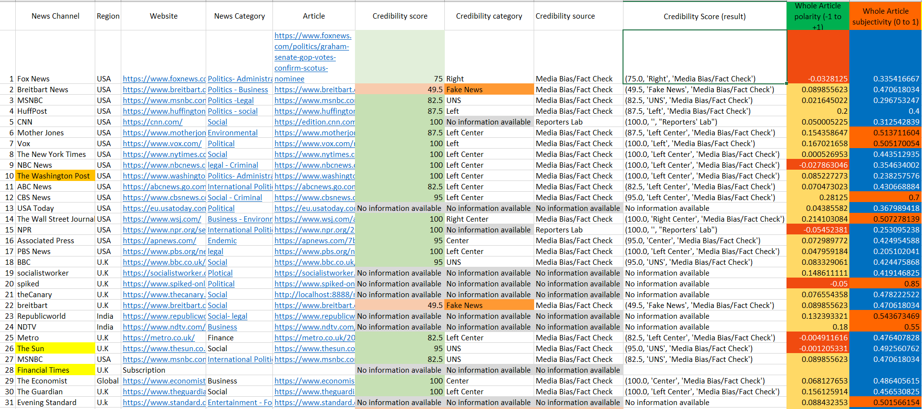
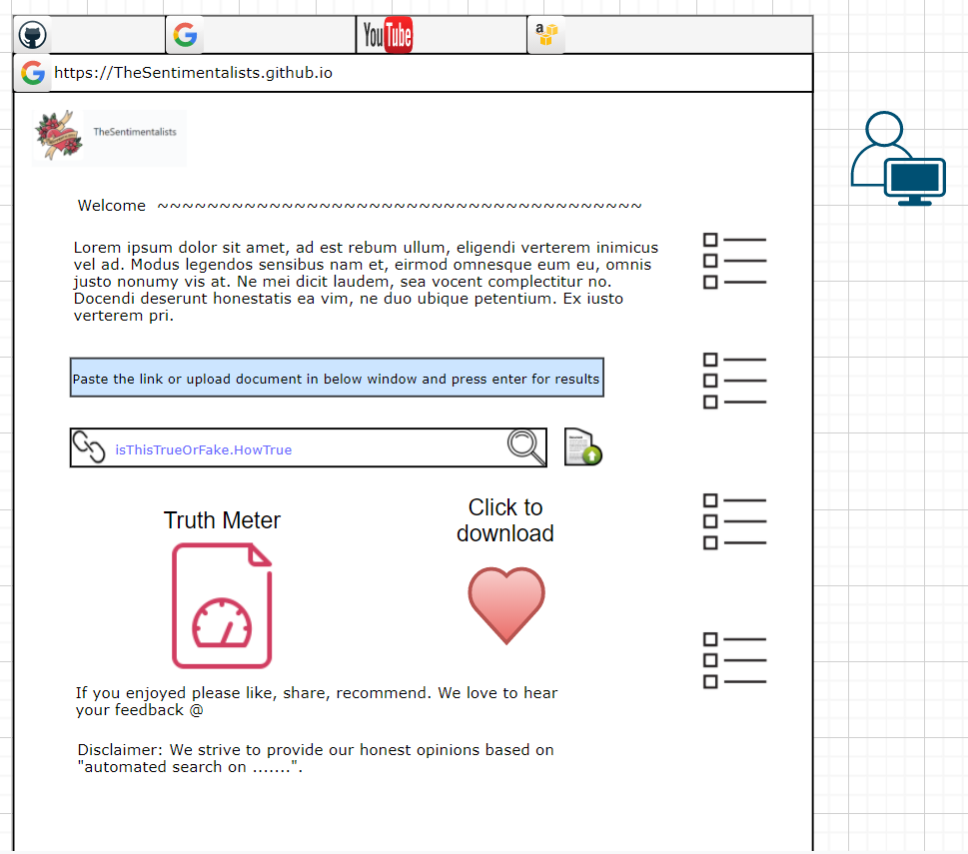
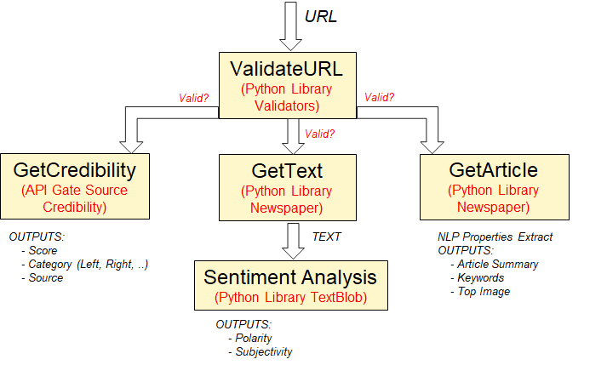
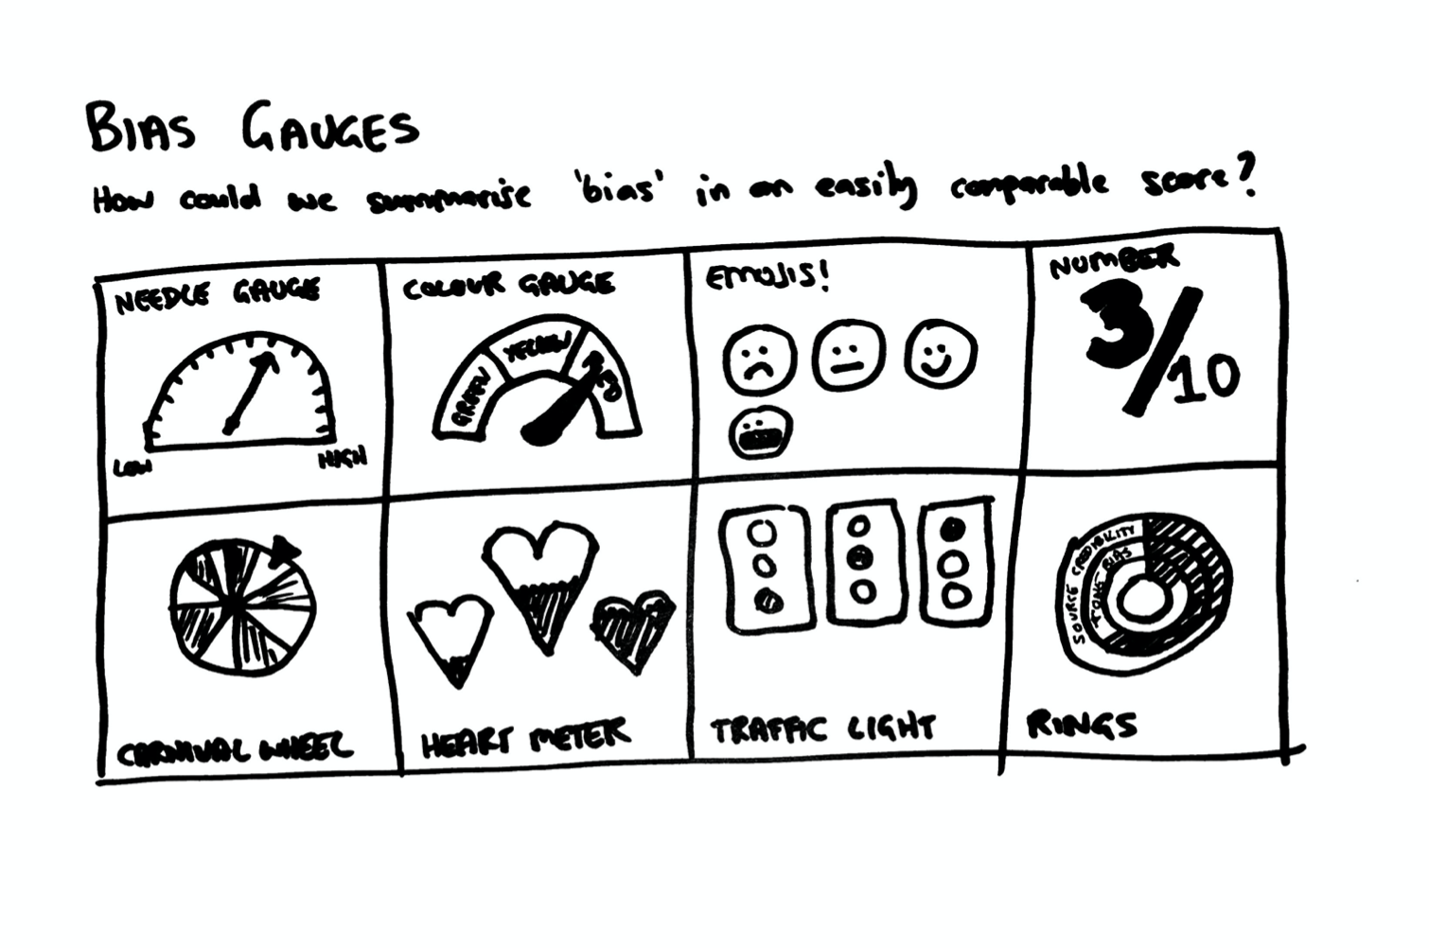
Ideas and Planning
Notes:
ELLIE
We came up with wireframes and design mock ups, testing out libraries and APIs, trying to work out what was possible!
Market research (looking at others in the space like Signal AI)
Heaps and heaps of ideas, too many to try and implement at once!
A comment from sprint reviews was a reminder that “you have limited time” which really focused us in and helped us make the right priority decision.
We used the MoSCoW methodology to split up and prioritise ideas so we had a coherent plan.
Not everything goes to plan though, and that’s OK. We were Agile and we adapted.
H/O to Ana (Collaboration)

Slide 10
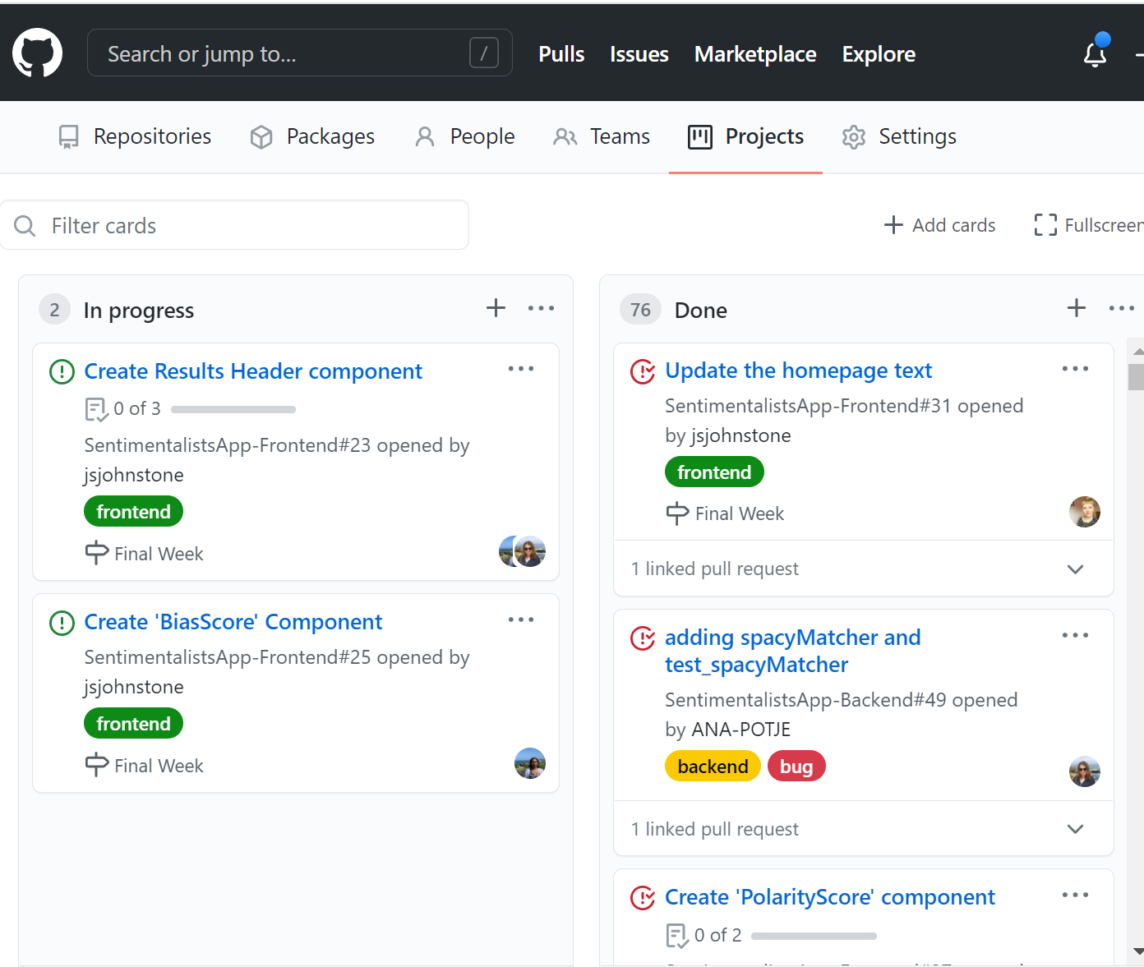
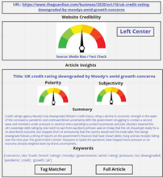
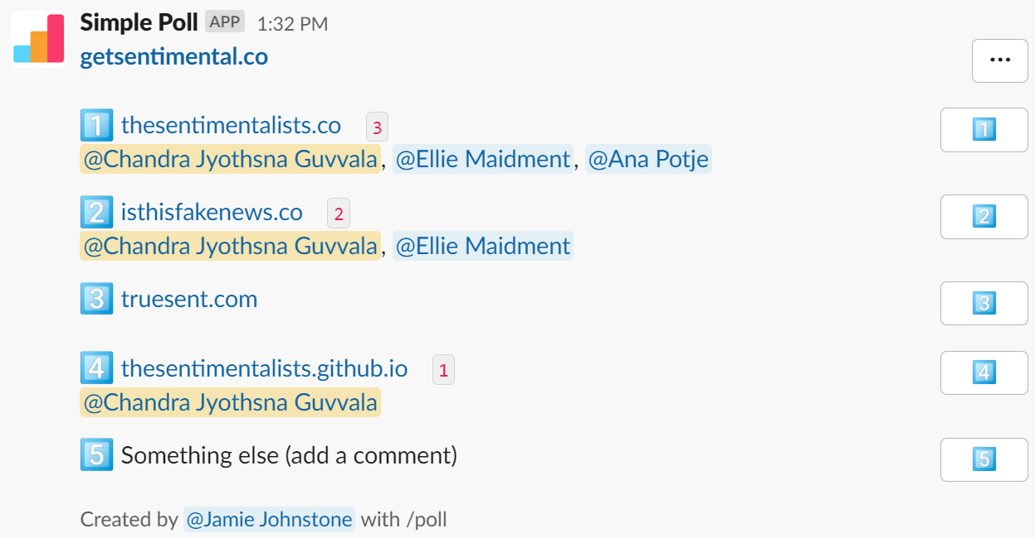
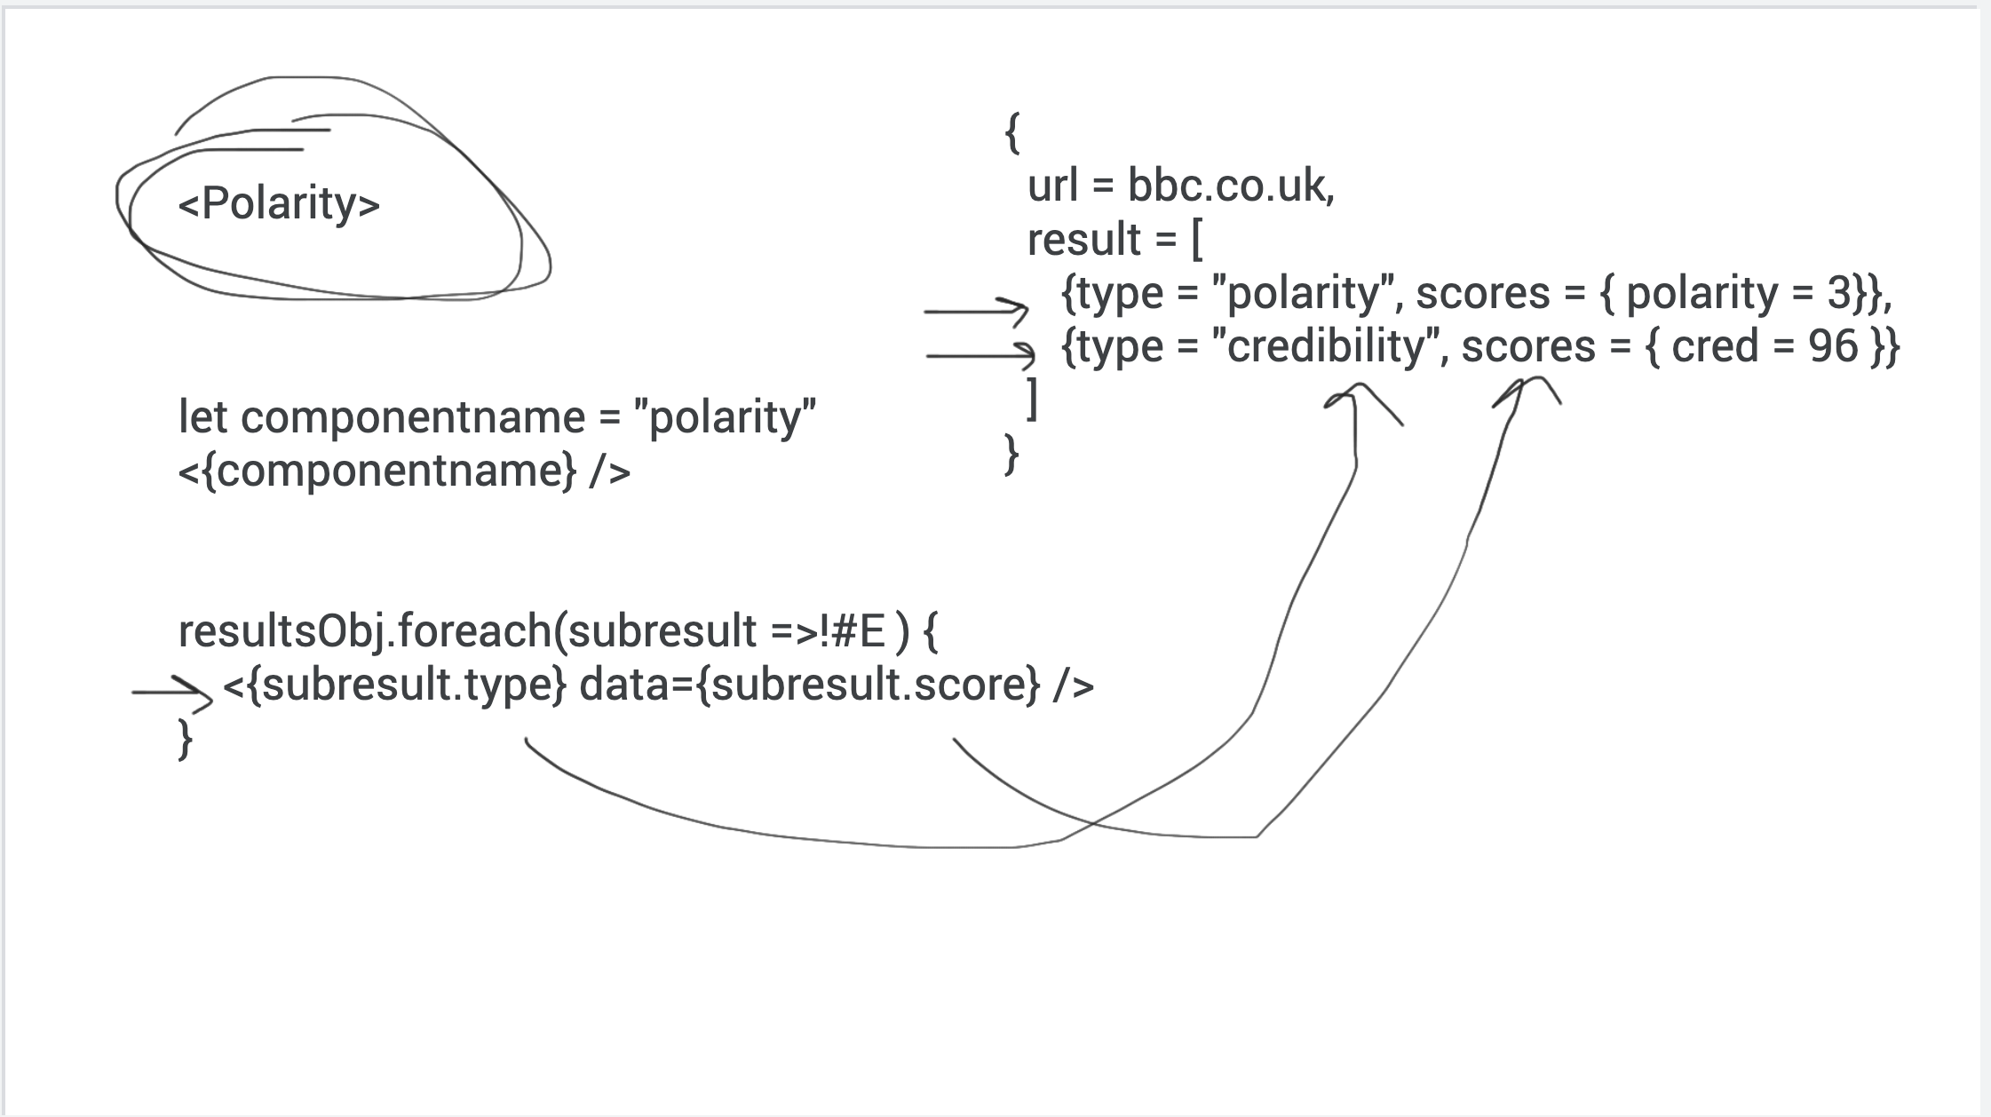
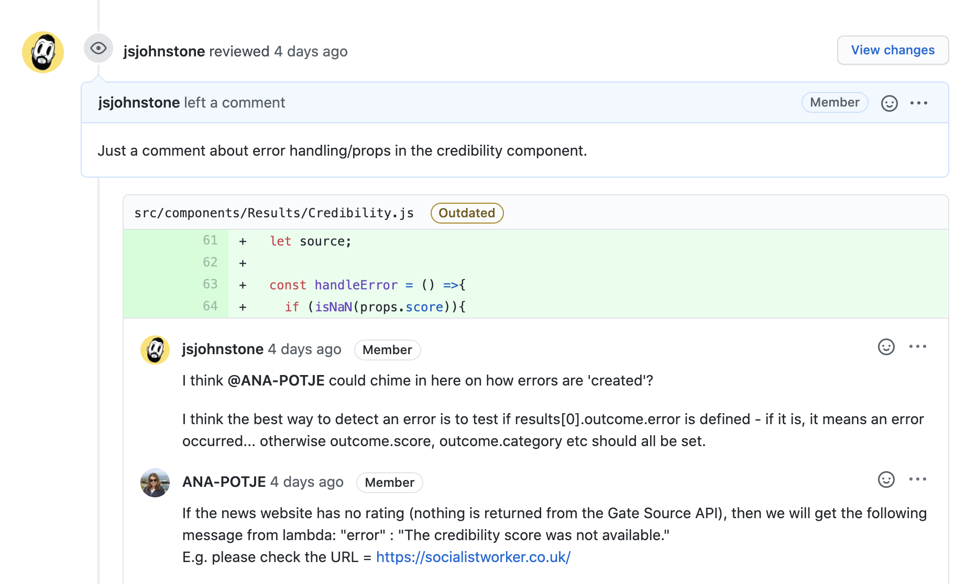
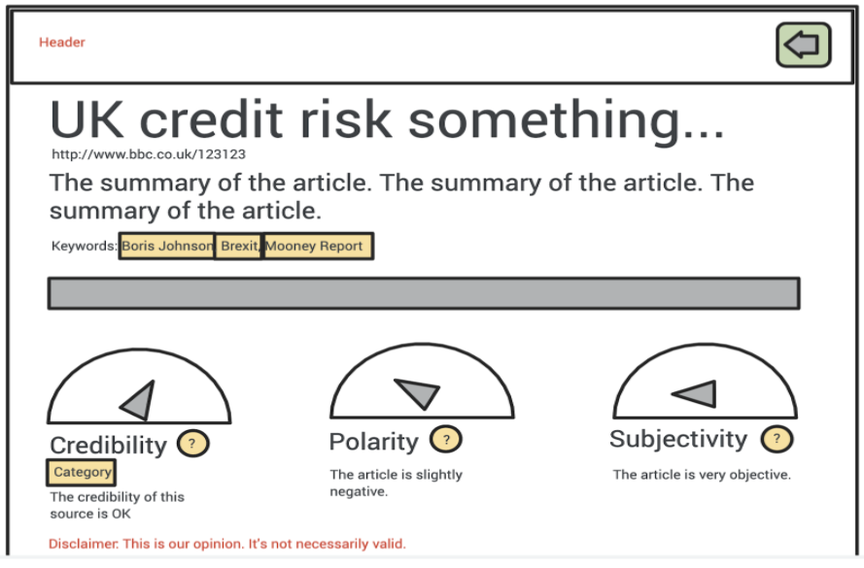
Collaboration
Notes:
ANA
Regular stand ups
Mockups created so new features could be discussed in our Zoom sessions
Simple Poll in Slack for voting on new ideas
Pairing Sessions: VSCode LiveShare, Zoom, Jamboard
GitHub “branches”: split the work / reviewed by peers / then MERGED!
GitHub Team Tracker where we could keep and manage our tasks
Several agreements and also disagreements - all managed at the end!
NEXT still Ana (Fun Stuff)

Slide 11
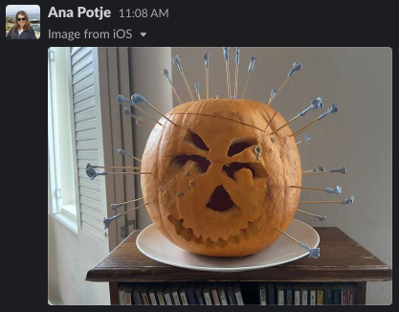
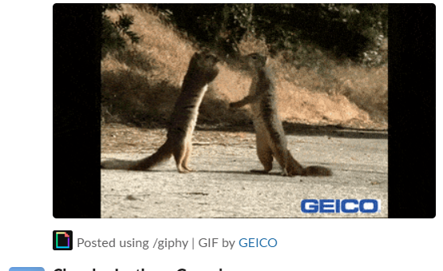

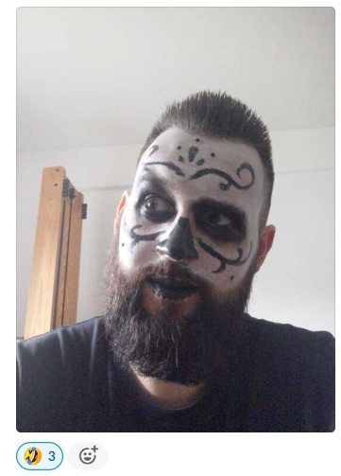
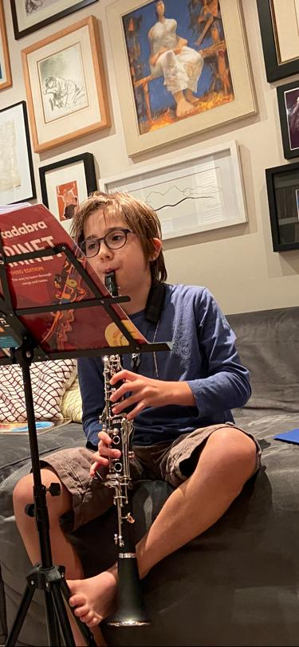
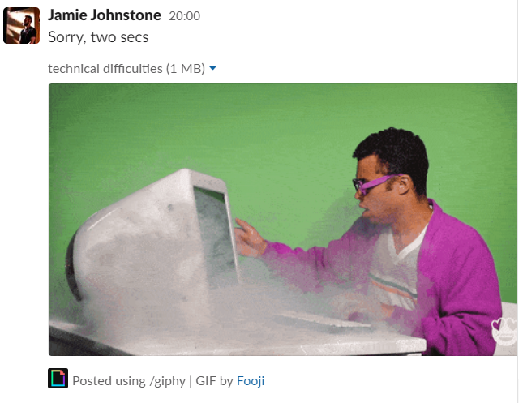

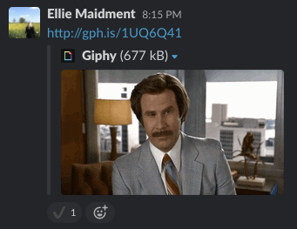
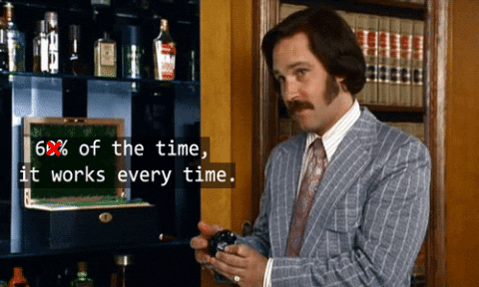
Fun Stuff!!
Notes:
ANA
Having a “clarinet concert” sometimes in the background of our Zoom sessions
Sharing funny GIFs in our Slack channel ...
… and some strange photos too!
H/O to JYOTHSNA (Continual Improvement)

Slide 12
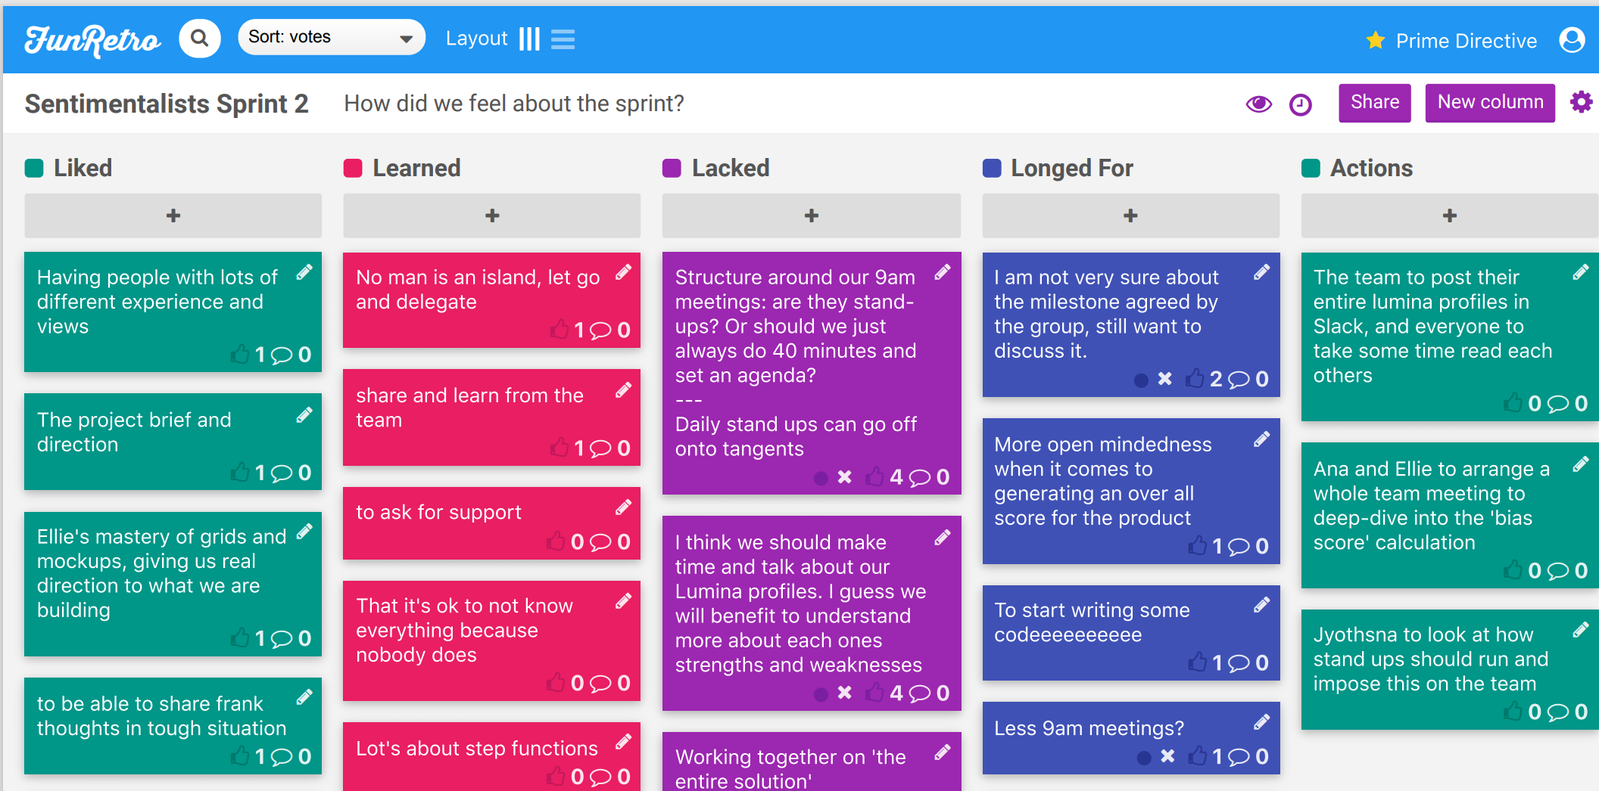
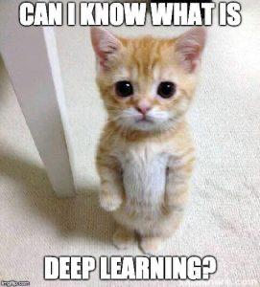
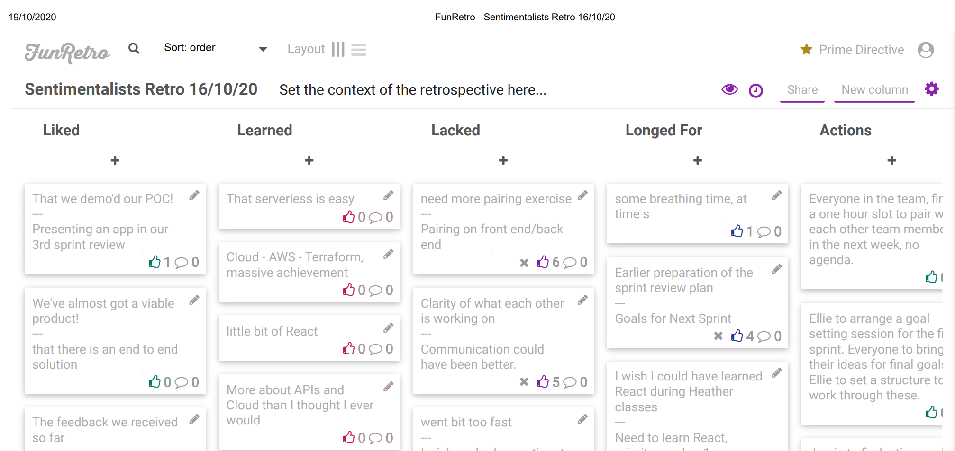
Continual Improvement
Notes:
JYOTHSNA
Following the first sprint review, we understood that this is a close teamwork and must address any pain points each one is going through , with in each sprint…….
And so, we decided to have Fun retros: this really helped us stay on track throughout …
Some of the highly voted actions we addressed are :
· Coming up with focused daily stand-ups … limiting to 10 minutes
· Have Clarity on each Sprint Goals – we versioned our project steps
· to Understand each other works by doing more pairing exercises and
· To understand each other’s work through knowledge sharing sessions
The Retros enabled us to have frank and open conversations and set clear priorities before each Sprint reviews …
--------------------------------------------------------------------
…. Over to Ellie who now will take you through what we build ….
----------------------------------------------------------------------

Slide 13
The Solution
Notes:
ELLIE

Slide 14
DEMO
Notes:
ELLIE (recorded demo)
H/O to Jamie (How it works)

Slide 15
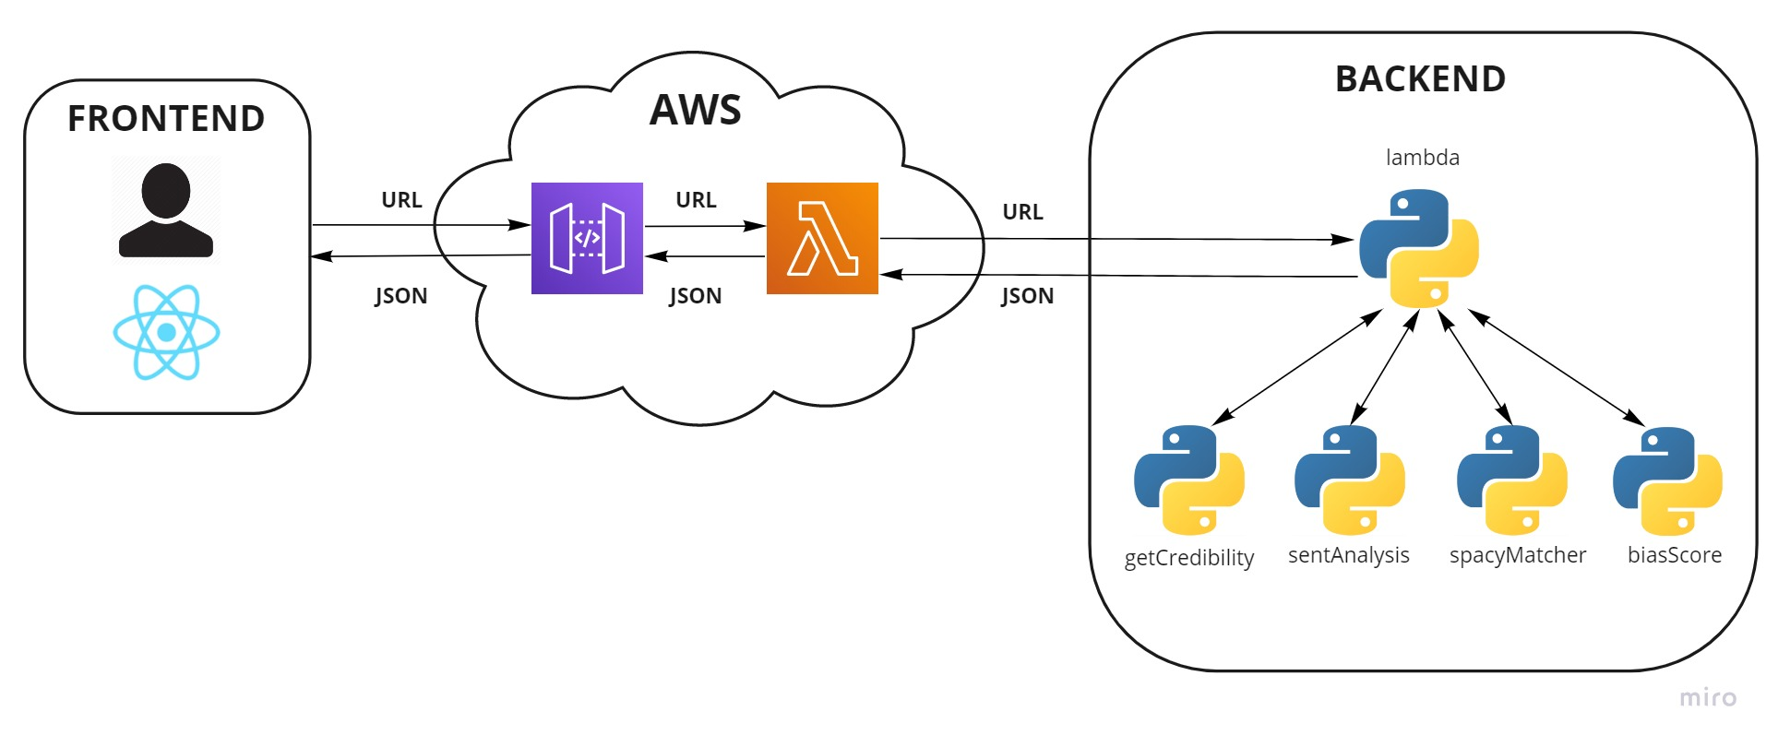







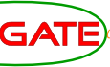


Architecture Overview
Notes:
JAMIE
Under the hood, the application uses a really simple REST API to pass requests back and forward between the front end user interface and the backend article analysis service hosted on AWS.
We went on quite a journey to get from a bunch of drawings to this final, simple architecture, and would love to dive into the decisions, technologies and challenges we encountered - here’s Ellie to start with the front end!
H/O to Ellie (How the frontend works)

Slide 16


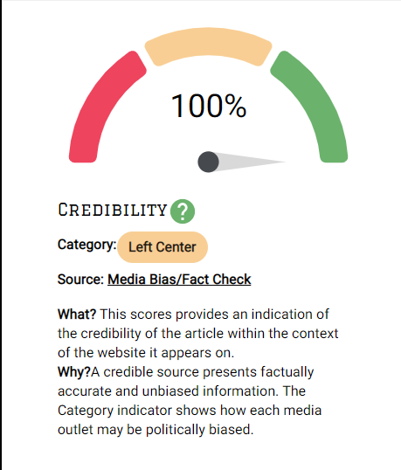
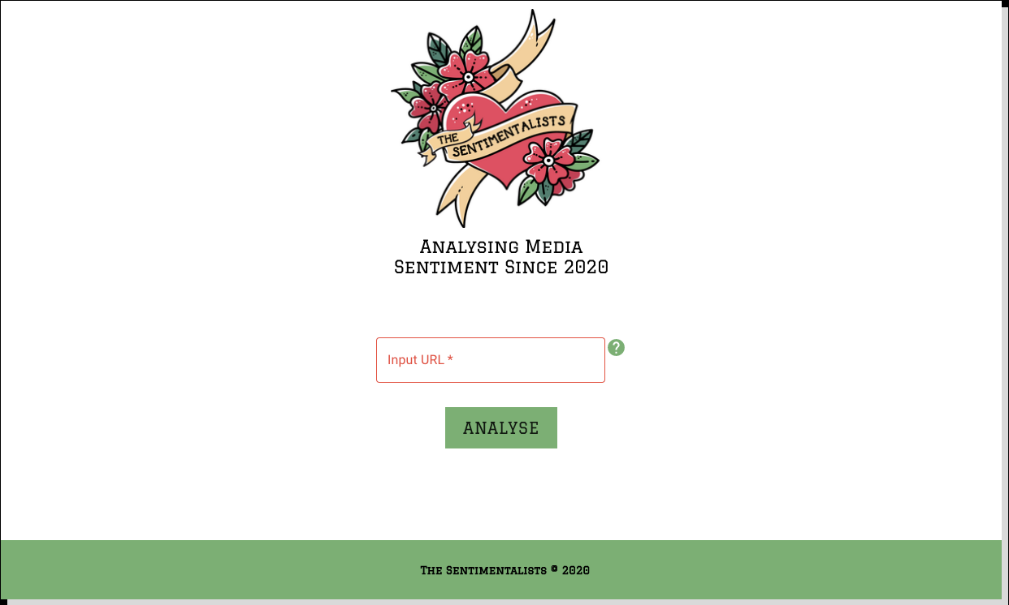
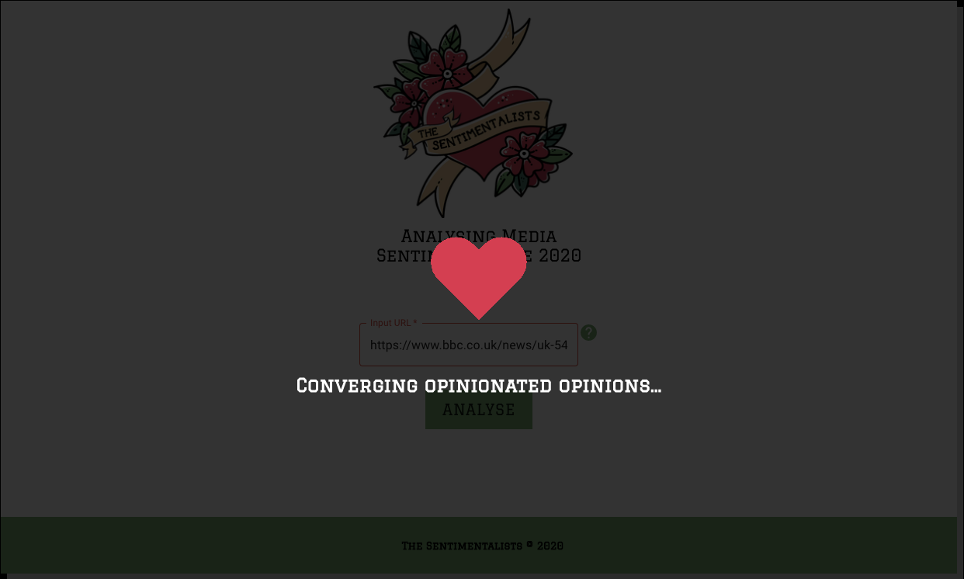
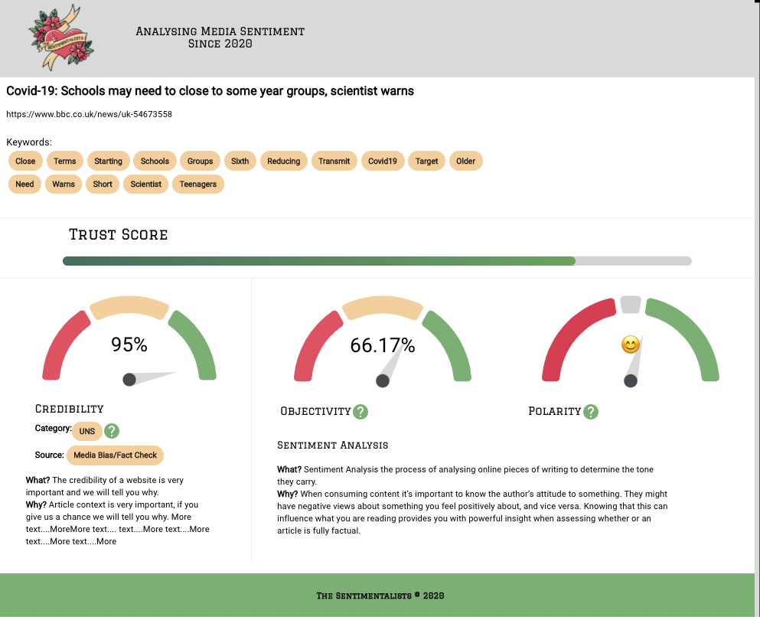


User Interface
Notes:
ELLIE
We all found React a bit of a challenge at the very beginning, but we knew it was going to allow us to build a fantastic user interface alongside the Material UI framework.
Experimenting with graph libraries and node packages was real highlight and while we couldn’t use all of them, it was vital in helping us understand crucial concepts like props and state.
It was really enjoyable to pair with each other while we were building the UI, it solved many of our a problems and allowed our creativity to flourish.
I wasn’t so keen on React at the beginning of the project, but now being part of a development team that’s implemented it, I’m a total convert.
H/O to Jyothsna (How we considered the user experience)

Slide 17




User Experience
Notes:
JYOTHSNA
User Interface:
As soon as we got results from the Libraries that Ana put in place …. We when through testing the logic with various news article to see what works and how…
we had numerous debates as how to present the information…. Made several models and choose few to implement ….
We wanted to present the information in a simplest way for the user … and decided on ‘Trust bar’ as that clearly answers user's question : ‘How much can I Trust the Article’
At the back end, we worked the logic using Python calculate Trust Score. This is tested on one article from 60 news Channels.
At the frontend, it was interesting to use React and Material – UI and got to pair with Ellie
Over to Ana for the details around the Core of the Project

Slide 18


Natural Language Processing
Notes:
ANA
NLP is a subfield of artificial intelligence
Main technical approaches
Rule Based Methods: fixed set of rules applied to make a final decision
Classical Machine Learning: trains a model, requires large amount of training data
Deep Learning: higher accuracy, emulates the architecture of the human brain to learn from data
For this project we opted for the Rule-based approach!
>>> ANA (Libraries)

Slide 19





NLP Libraries & APIs
Notes:
ANA
Python NLP Libraries used in this project:
TextBlob: relies on a vocabulary of words with predefined sentiment value; overall sentiment calculated based on each word in a text.
Newspaper: method “nlp()” used to obtain summary and keywords of the article.
SpaCy: rule-based matcher lets us search for specific entities in a text (e.g. person, location, numeral etc)
Gate Source Credibility API
Score, category (Fake news, Right / Left wing ...) and source
H/O to JAMIE (Infrastructure)

Slide 20



Infrastructure
Notes:
JAMIE
We started exploring architectures from day one and came up with 5 initial architecture designs, from the very simple to more complex involving multiple workflows in parallel, document databases, asynchronous calls or web sockets. But through our planning process, decided on the frontend and backend solution you’ve just seen, and this simplicity has meant we were able to start coding fast.
To help iterate even faster, we invested time automating large parts of our process - from running automated tests with pytest, to managing our infrastructure with modularised terraform components, to getting our code built, packaged and deployed to AWS Lambda and Github Pages with an automated pipeline.
An interesting win was using docker containers in these pipelines to ensure python binaries were compiled for the correct production environment.
CLICK The use of AWS also enabled easy access to tools like X-Ray which played a big part in helping profile our app and understand where we could make performance improvements. We had really pushed our chosen architecture pattern to it’s limit, and have identified some future opportunities to split up our already modularised codebase, conduct analysis in parallel, and deliver a scalable service.
Speaking of the future opportunities, Jyothsna’s going to tell you a little more about the future of The Sentimentalists….
H/O to JYOTHSNA (Future opportunities)

Slide 21

Infrastructure
Notes:
JAMIE
CLICK The use of AWS also enabled easy access to tools like X-Ray which played a big part in helping profile our app and understand where we could make performance improvements. We had really pushed our chosen architecture pattern to it’s limit, and have identified some future opportunities to split up our already modularised codebase, conduct analysis in parallel, and deliver a scalable service.
Speaking of the future opportunities, Jyothsna’s going to tell you a little more about the future of The Sentimentalists….
H/O to JYOTHSNA (Future opportunities)

Slide 22







Future Opportunities
Technical:
Tech For Good:
Notes:
JYOTHSNA
Thanks again Jamie 😊
We see a large scope for the App:
We have lot of ideas to implement given more time …. Like
· even richer interactive app
· Much robust error handling
· Better Architectural Efficiency – handle loads, faster
Additional capabilities like
· article comparison,
· a Machine learning model,
· setting up user profiles
On commercial side, we see large scope, some examples are:
· Use in Education, research
· Could be integrated with social media platform like … WhatsApp, Facebook, twitter etc.. to address issues around circulation of fake news
· As a browser extension …
· for organizations like ‘Impaakt’ that produce research articles
Over to Ellie on …. interesting reflections

Slide 23
Final Thoughts
thesentimentalists.github.io
Notes:
ELLIE
We’ve learned a lot from the programme and grown as a team and individuals
Massive thanks to: the Tech Returners team for being, quite frankly, amazing.
Thanks to Eigen for a really inspiring project brief, I hope we’ve done it justice.
our friends and family who’ve been unquestionably supportive of all the time we’ve spent with strangers on Zoom
And thanks to you all for watching our presentation!
CLick to Thank you!

Slide 24


Slide 25
Questions?
thesentimentalists.github.io

